Slide 1
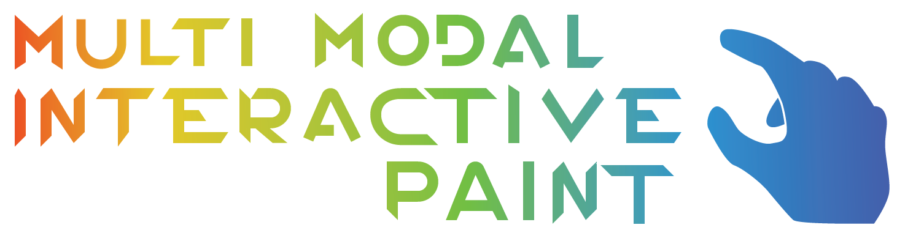
Team
Andrew Mitchell – Mainly developed with Multitouch and Drawing Capabilities
Garrett Lemieux – Mainly developed using Real Sense and Leap Motion Devices
Product Owner
Dr. Francisco R. Ortega

Slide 2
Problem definition
Problem:
How can we showcase the Smart Desk?
We want a fun and interactive application to showcase the devices available for students on the Smart Desk.
We need a streamlined application to test various devices and discover their potential and limitations.
Notes:
Introduce the problem that the whole project tackles and stay focused on the parts that you have been working. Indicate if there is an existing previous system, enumerate its problems/limitations, etc.

Slide 3
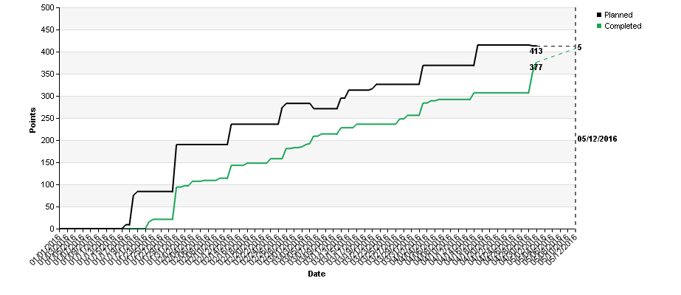
Project Management
Burn Up Chart
With the exclusion of a few ‘future’ user stories that will be added to the backlog for the next semester, our team completed all of our tasks for the Semester, completing even more than our product owner could have imagined!

Slide 4
Requirements
We were employed with creating a painting application that benefitted from these unique input methods
Touch Pad
Eye Tracking
Hand Recognition
Facial Expressions
Implementing basic paint functionality is crucial for the applications development. The program should be able to perform functions such as
Drawing
Changing Colors
Changing Shapes
Layer Support
An intuitive UI and control over input devices is also needed for testing these new technologies and discovering how best to use them as well as their limitations.

Slide 5
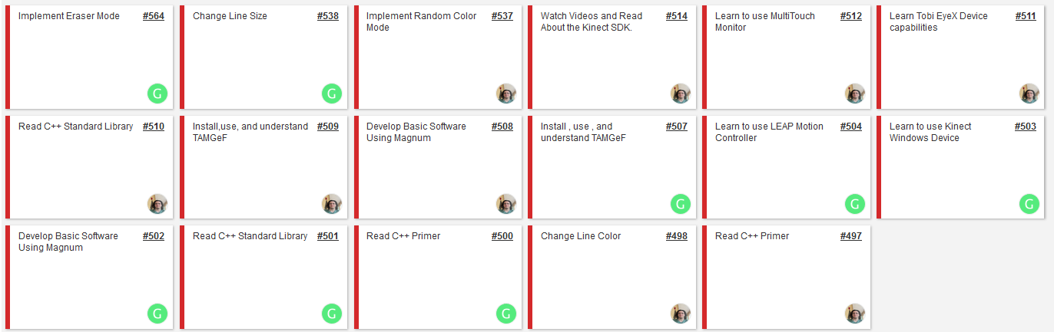
Sprint 1
Familiarized ourselves with C++
Reviewed previous OpenHID projects
Research and installed necessary devices
Implemented basic drawing functions

Slide 6
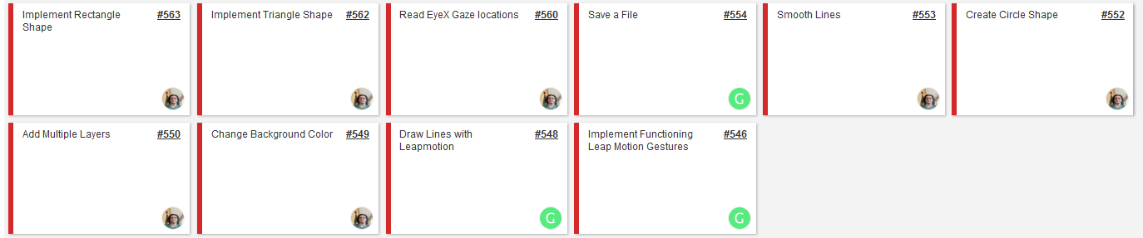
Sprint 2
Implemented basic leap motion drawing and gestures
Expanded on multitouch drawing with addition of shapes and multiple layers
Implemented eyeX gaze tracking

Slide 7
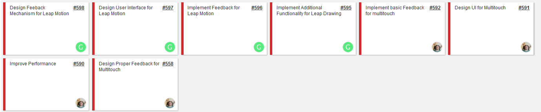
Sprint 3
Designed user interface for devices
Implemented Basic feedback for each device
Added additional features to leap drawing and improved line draw performance

Slide 8
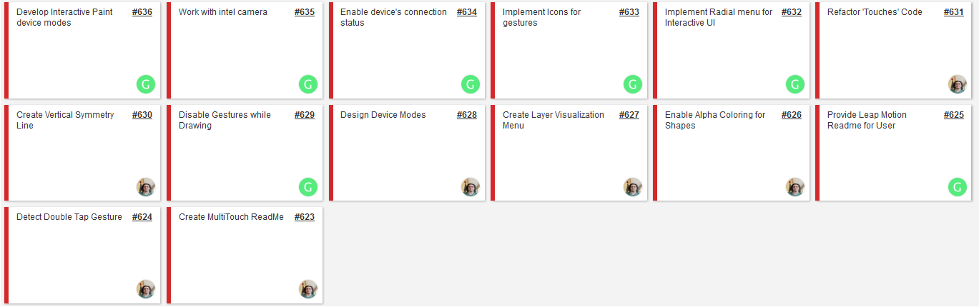
Sprint 4
Implemented device connections status
Began working with real sense device
Additional features for multitouch implemented such radial menu, layer visualization, and double tap gesture
Added symmetry capabilities to draw functionality

Slide 9
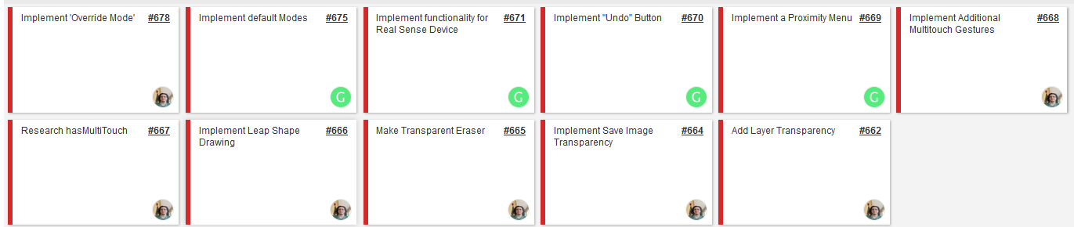
Sprint 5
Added Real Sense Device to Application
Implemented Transparency into Application
Provided leap motion with a proximity menu and draw shapes to allow for similar functionally as multitouch

Slide 10
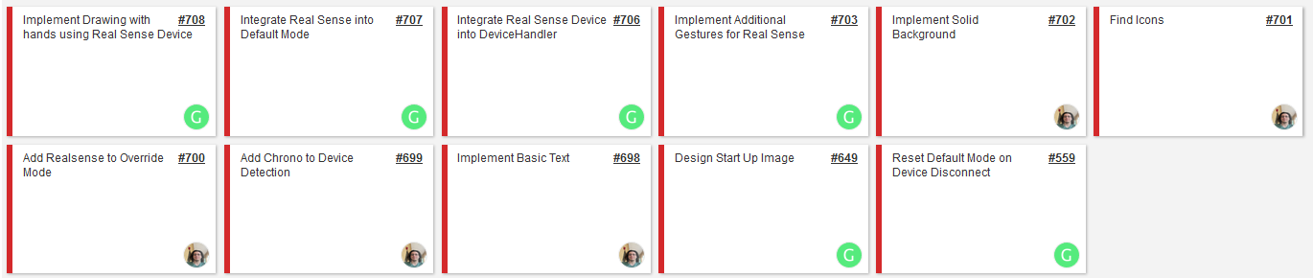
Sprint 6
Fully integrated real sense into application and added new input in form of facial gestures.
Implemented drawing feature with Real Sense
Created a keyboard for user to allow for basic text to be used within application.

Slide 11
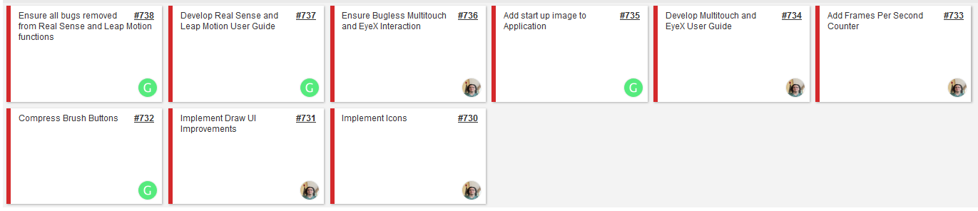
Sprint 7
Improved efficiency of applications UI
Implemented more intuitive icons
Organized UI buttons

Slide 12
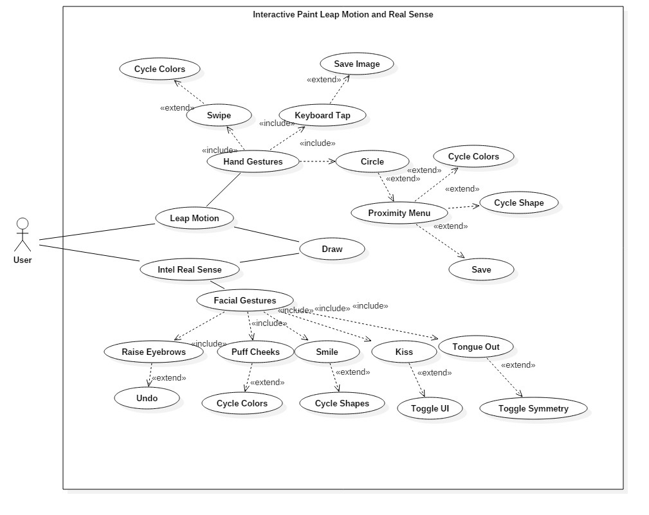
Leap Motion and Real Sense Use Case Diagram

Slide 13
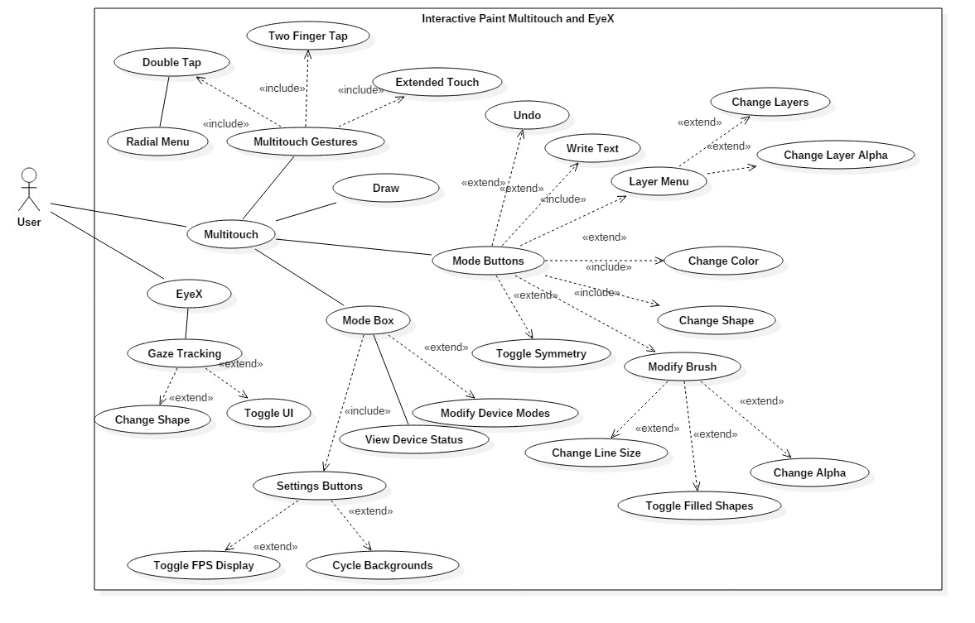
Multitouch and EyeX Use Case Diagram

Slide 14
Leap Motion Feedback to User Use Case
As a User I would like feedback when I switch drawing modes using the Leap Motion device and interact with UI so I know intended actions with Leap Motion were successful.
Actor : User
Preconditions :
Leap Motion must be connected to TouchPointsApp
Acceptance Criteria
Provide feedback in the form of an image
Gesture must change current setting

Slide 15
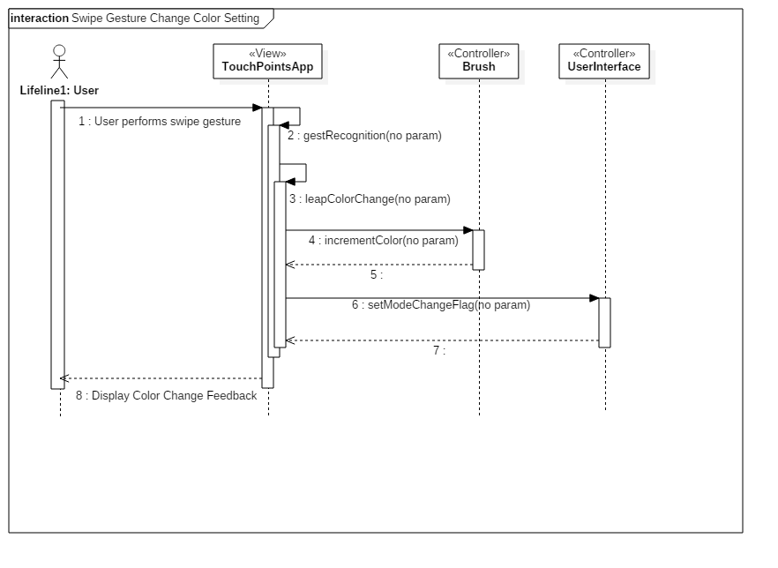
Leap Motion Swipe Gesture Feedback Sequence Diagram

Slide 16
Real Sense Facial Gesture Use Case
As a user I would like to be able to perform additional Gestures in order to allow more interaction with paint program using Real Sense device.
Actor : User
Preconditions :
Real Sense device is connected
TouchPointsApp is running
Acceptance Criteria
Create new gestures
Each gesture must perform a different function

Slide 17
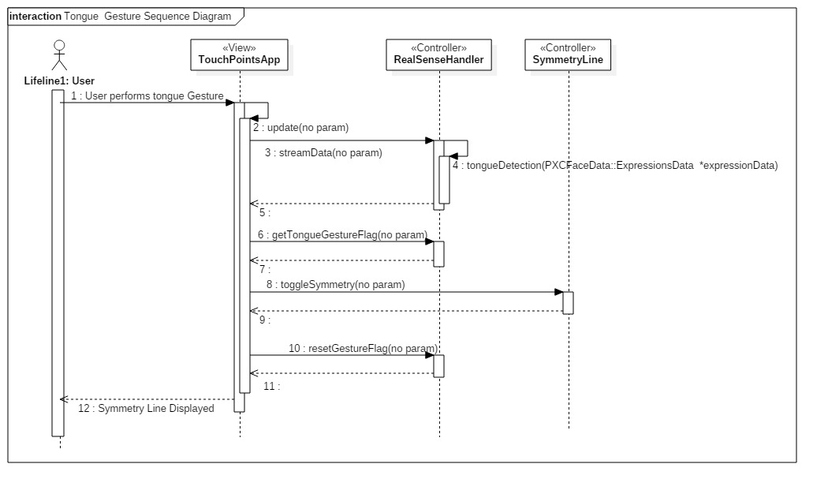
Real Sense Sequence Diagram

Slide 18
Multitouch Draw Circle Use Case
As a User I would like to draw a predefined circle so my circles are smooth.
Actor : User
Preconditions :
Working ‘Draw’ Device (Multitouch, Leap, Real Sense)
Acceptance Criteria
Enable drawing of circles
Circles can be various sizes

Slide 19
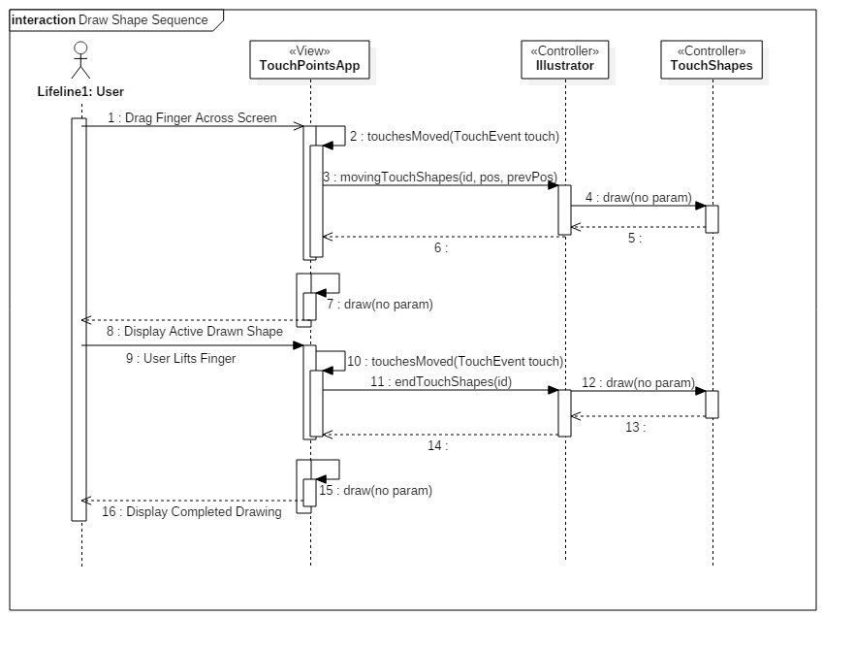
Multitouch Draw Circle Sequence

Slide 20
Toggle Symmetry Use Case
As a User I would like to enable a Symmetry Line so I can easily draw on both sides of the canvas at once and make symmetric drawings
Actor : User
Preconditions
Working ‘draw’ device is running. (Multitouch, Leap, Real Sense)
Acceptance Criteria :
Be able to draw on the either side of the canvas, and have the line reflected over a vertical line.
Must be able to toggle on and off.

Slide 21
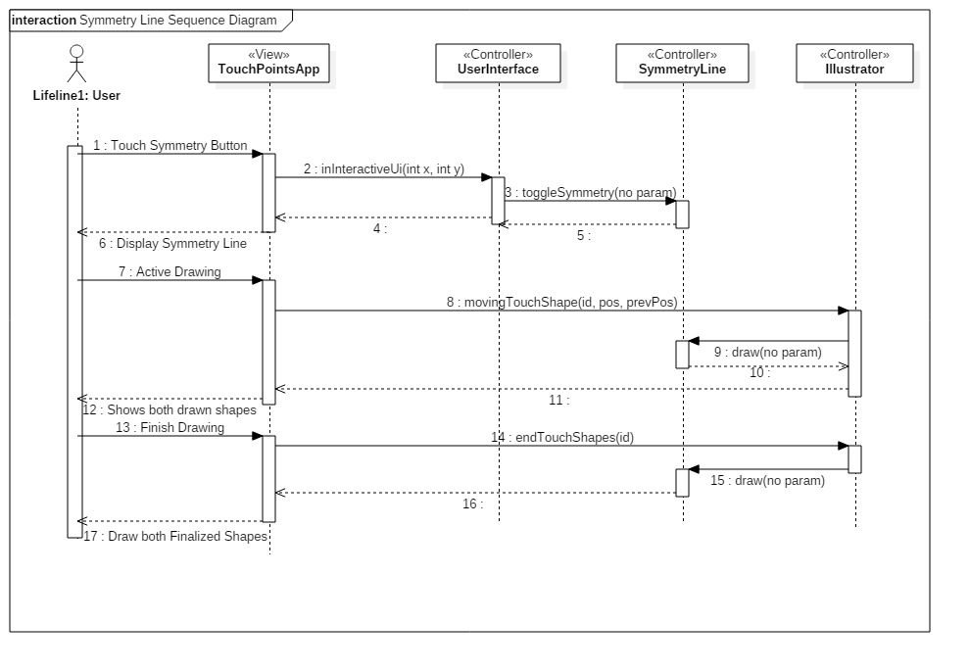
Symmetry Line Sequence

Slide 22
System Design
Model View Control Architecture
View : TouchPointsApp runs a constant draw method using an OpenGL Context in addition to updating the program on any user interactions.
Control : The remainder of our implemented classes act as a controller to handle devices and the applications status.
Model : LibCinder Frame Buffer Objects store any persistent data we need such as the drawing layers.

Slide 23
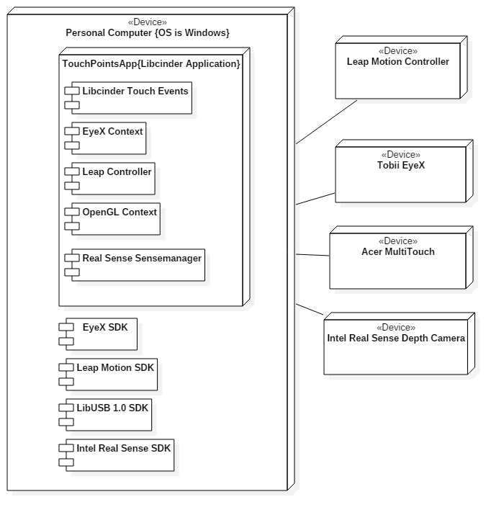
Deployment Diagram

Slide 24
Hardware and Software Requirements
Hardware Requirements
Acer Multitouch Monitor
Tobii EyeX
Windows PC (Tested with Intel core i5 Processor)
Leap Motion Controller
Intel Real Sense Depth Camera
Software Requirements
Microsoft Visual Studio 2013 with C++
Windows 10
Libcinder 0.9.0
Tobii EyeX SDK 1.6
Intel Real Sense SDK 8.0.24.6528
Leap Motion SDK 2.3.1
LibUSB 1.0

Slide 25
Persistent Data Design
No need for mass data storage.
We save only a few different OpenGL Contexts (Images)
Mainly used for layering the users images.
We use LibCinder Frame Buffer Objects to store this data in main memory.
These Frame Buffers last for the processes lifetime.
We can also save the users images to their hard drive.

Slide 26
Security and Privacy Concerns
This is an offline application.
No secure information is transferred or stored.

Slide 27
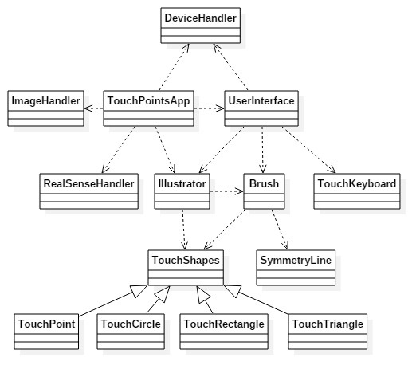
Minimal Class Diagram

Slide 28
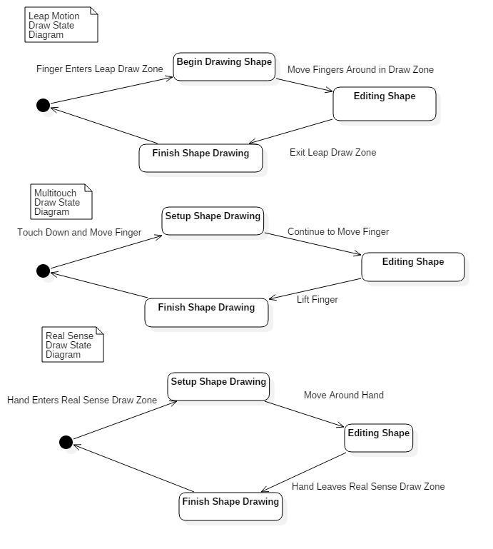
State Chart Diagram

Slide 29
Symmetry Line Algorithm
User turns on symmetry by using a touch button
User draws a shape on the current canvas
Identify the current shape being drawn and pass it to the symmetryLine class
Calculate the relevant symmetry points for the given shape and symmetry line, then create a new shape.
Return the newly created symmetric shape
Draw the symmetric shape to the canvas.

Slide 30
Sunny Day Test
Test ID | Symmetry Line – Draw Line
Test Purpose | Check to see if the user can successfully draw a line symmetric to our ‘Symmetry Line’
Test Setup | Tap the Symmetry Line button Tap the ‘Line’ shape button Begin drawing line
Test Output | Drew a line opposite our line of symmetry whenever the user draws a line of any size or color.
Expected Output | Two lines should be drawn every time. The lines should be on opposite sides of the current line of symmetry.

Slide 31
Rainy Day Test
Test ID | Symmetry Line – Turn off Symmetry
Test Purpose | Ensure Symmetric Lines don’t draw when it is turned off.
Test Setup | User toggles the symmetry line on. Then the user toggles the symmetry line off.
Test Output | User drew a circle. Only one circle was drawn. User drew a line. Only one line was drawn.
Expected Output | Only a single shape should be drawn for each touch input.

Slide 32
High Level Demo
The Demo will cover the basic features of following devices:
Multitouch Screen
Leap Motion
Real Sense
Leap Motion hand gestures and Real Sense facial gestures will be shown in a more detailed video.

